Slide 1

Zowe TSC 21PI1
Jakub Balhar & Michael Bauer, TSC Members

Slide 2

Mission:
Reduce the learning curve
Attract new people to z/OS
Simplify architecture
Benefits:
Zowe is an integrated and extensible open source software for z/OS with a coherent and curated set of user and programmatic interfaces that:
Provide consistent access to z/OS systems and services
Leverage industry standard methodologies and standards familiar to the vast majority of today’s developers and IT staff
Are commonly accepted as a standard within the mainframe community
What’s next:
Simplify configuration of client components (Zowe Client SDKs, CLI, & Explorer VS Code Extension)
Support high availability of the API Mediation Layer and Web Desktop
Leverage data to track the security, health and performance of the API Mediation Layer
Improve the onboarding experience & conformance program updates
Improve Zowe release predictability & reliability
zowe.org

Slide 3
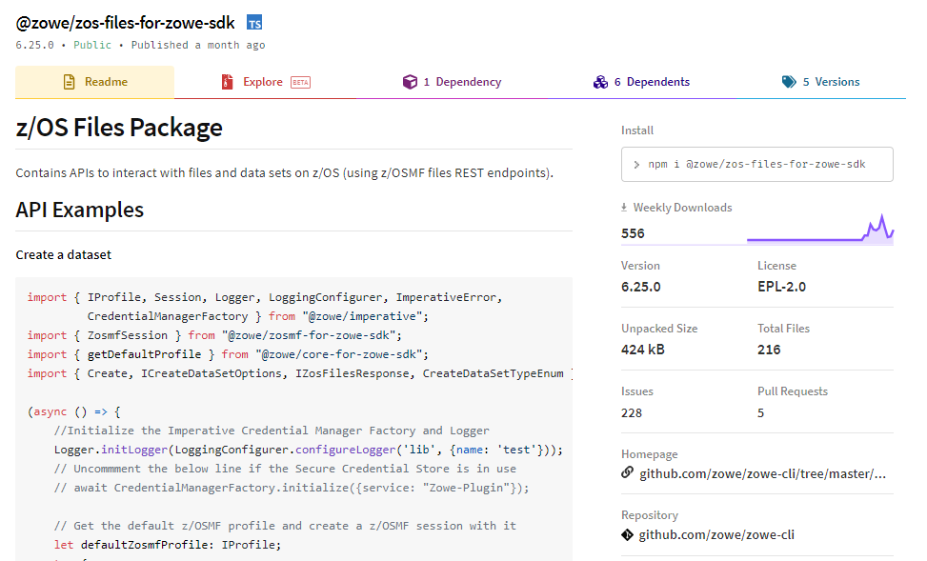
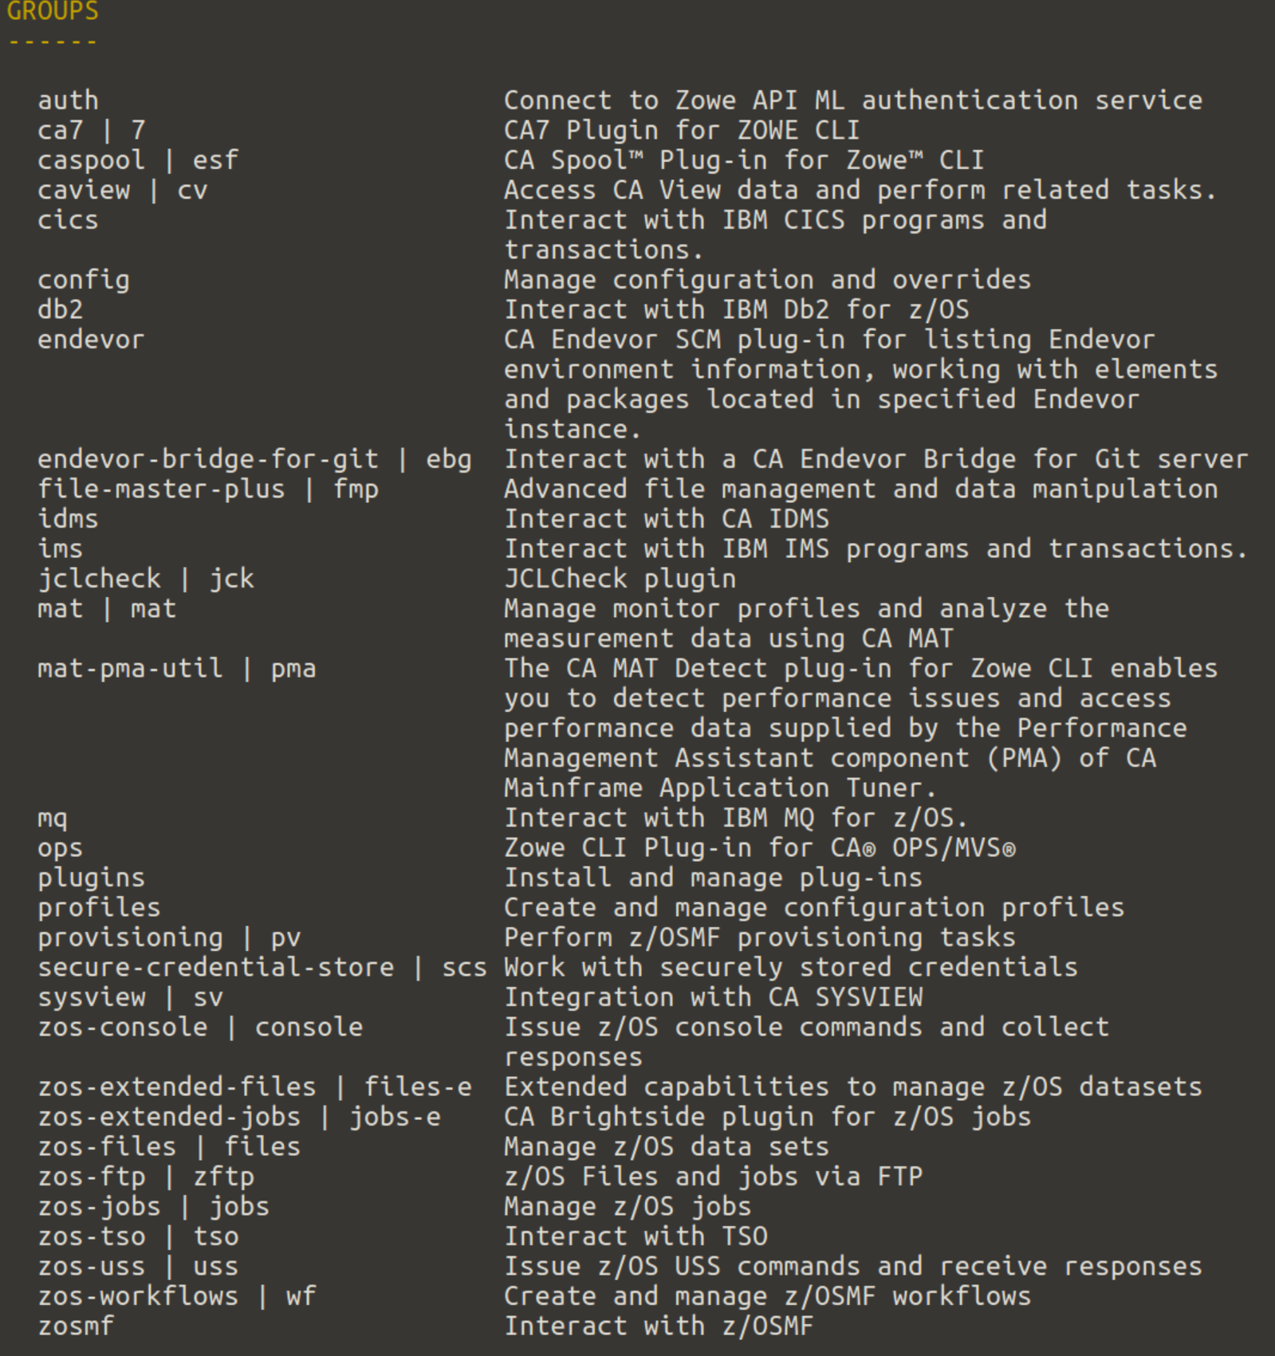
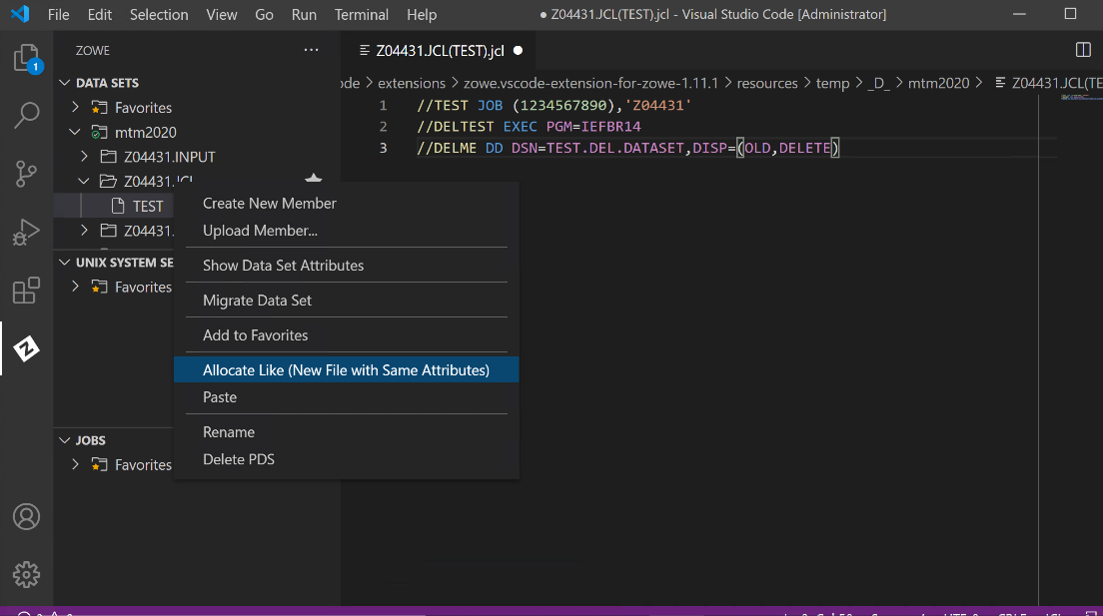
Improve Onboarding Experience of Zowe Client Technologies
Focus remains on attracting new people to the mainframe platform and reducing the learning curve
Client configuration is one obstacle to leveraging Zowe client technologies.
We seek to reduce the number of individuals who need to manage client configuration by making it easy to share across organizations and technologies.
For those few who will construct client configuration, we seek to leverage the API Mediation Layer to abstract some complexities.

Slide 4

High Availability - Stay safe under stress
“Everything is fine. I have no idea what you are talking about”
Resilience in the face of chaos.
Zero Downtime
Notes:
The catastrophe - The things will fail down, the datacenter may be attacked by angry mob or the earthquake can take it down. There is no reason for this to stop your operations.
Multi LPAR deployments
Single LPAR increased availability

Slide 5

Hybrid Environments
On-premise on-platform
Battle tested mission critical infrastructure
On-premise off-platform
Support to the mission critical with limited data transfer
Cloud off-platform
Experimentation, More flexible capacity
Notes:
Even more so with concerns around the cloud environments and the possibility to depend on them limited by the politics.

Slide 6

Use the metadata properly
Improve understanding of the data around Zowe and automate its collection.
Provide actionable insights based on the data produced while using the Zowe.
Optimize the resource usage automatically.
Notes:
The data about the

Slide 7


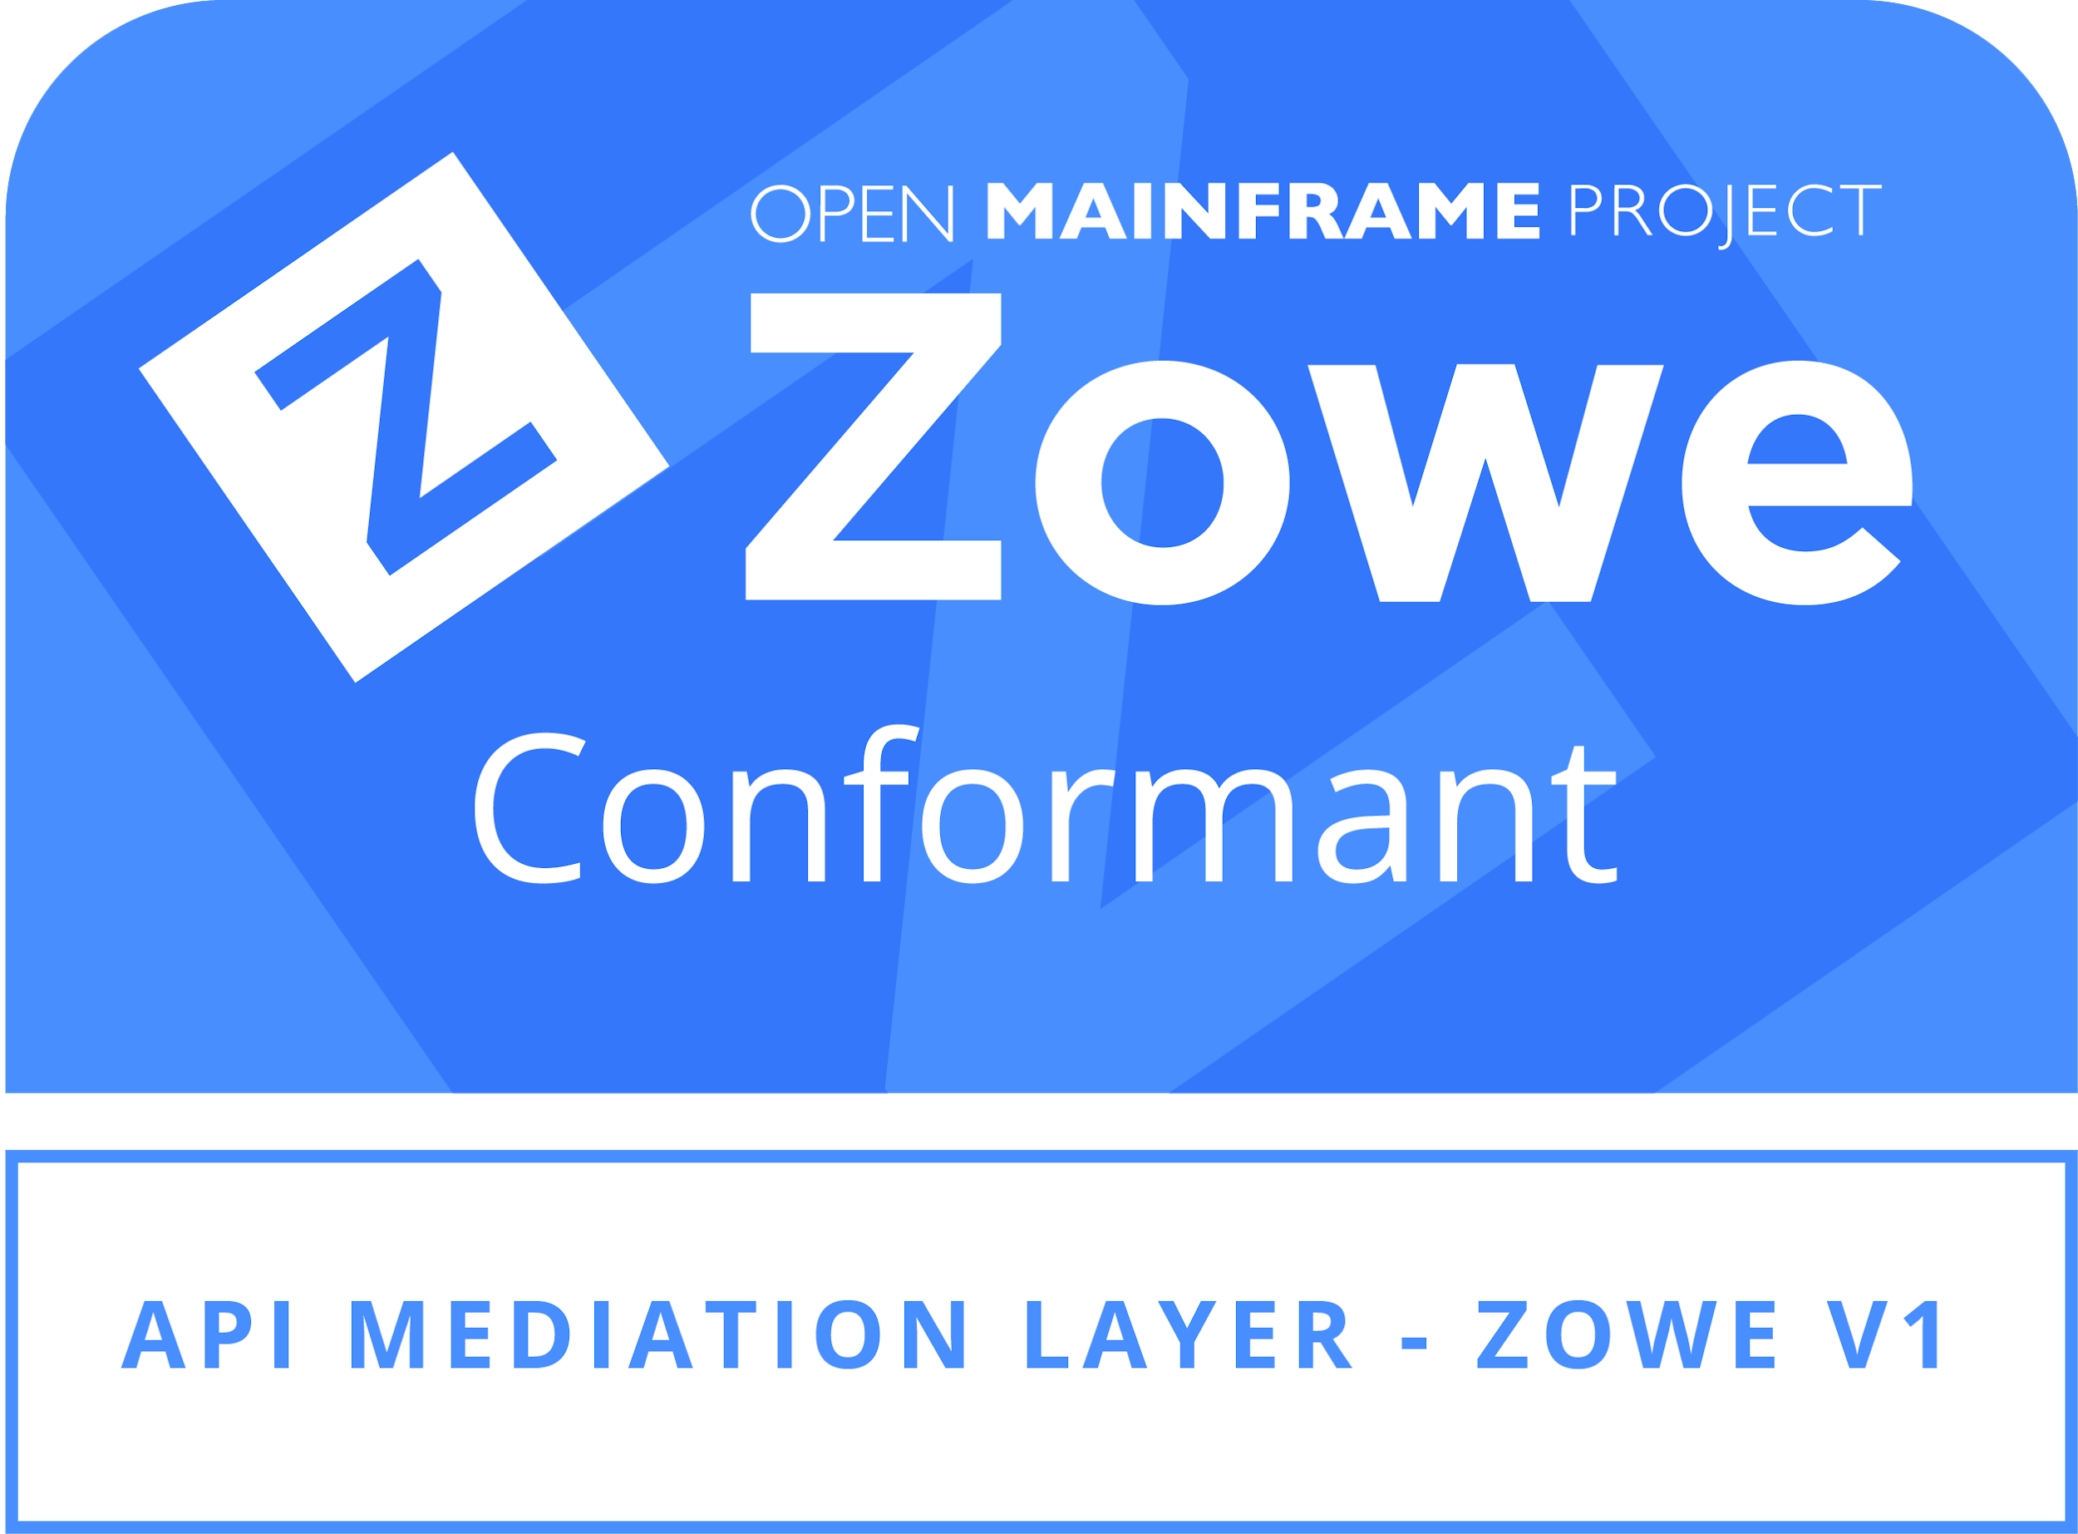

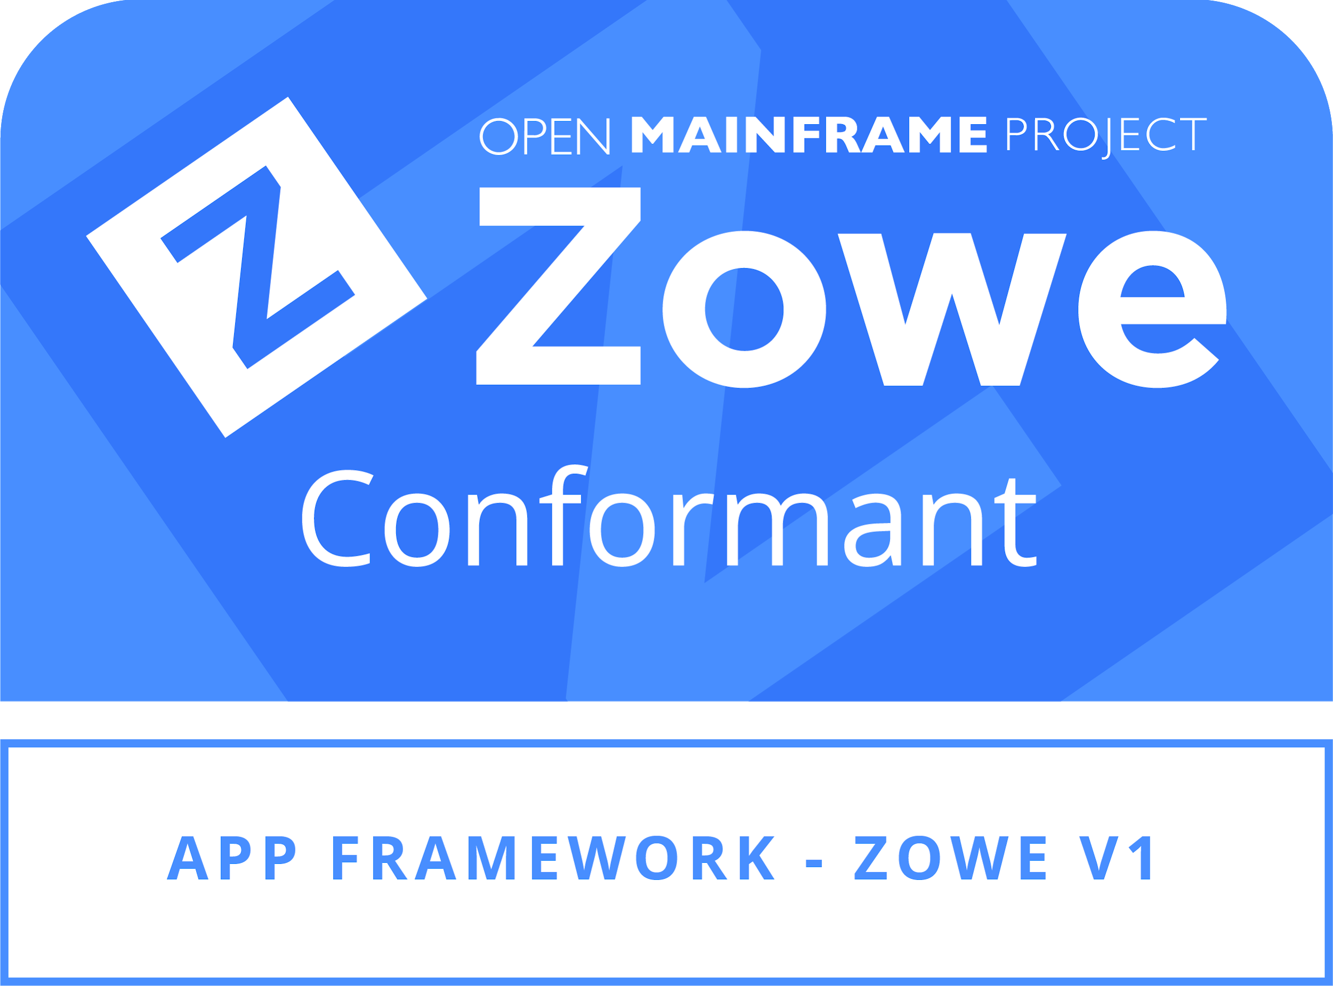
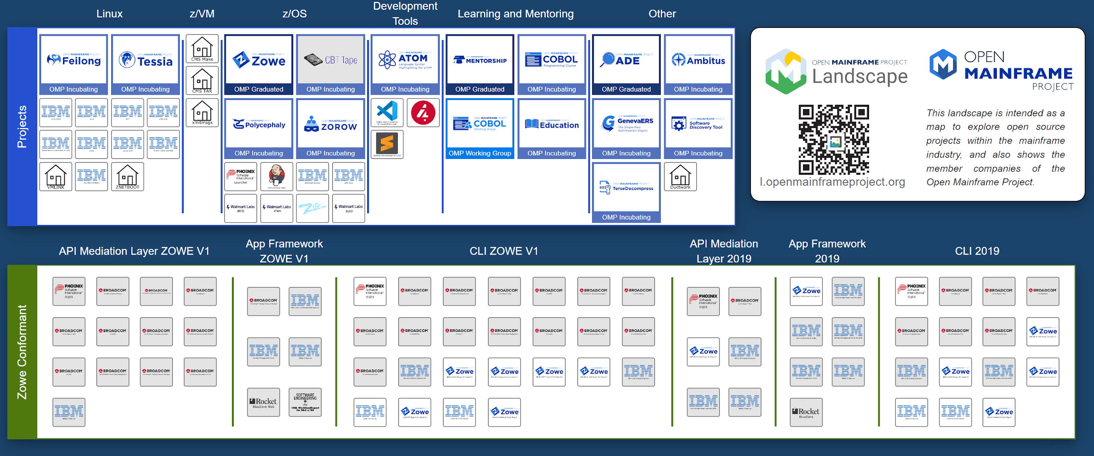
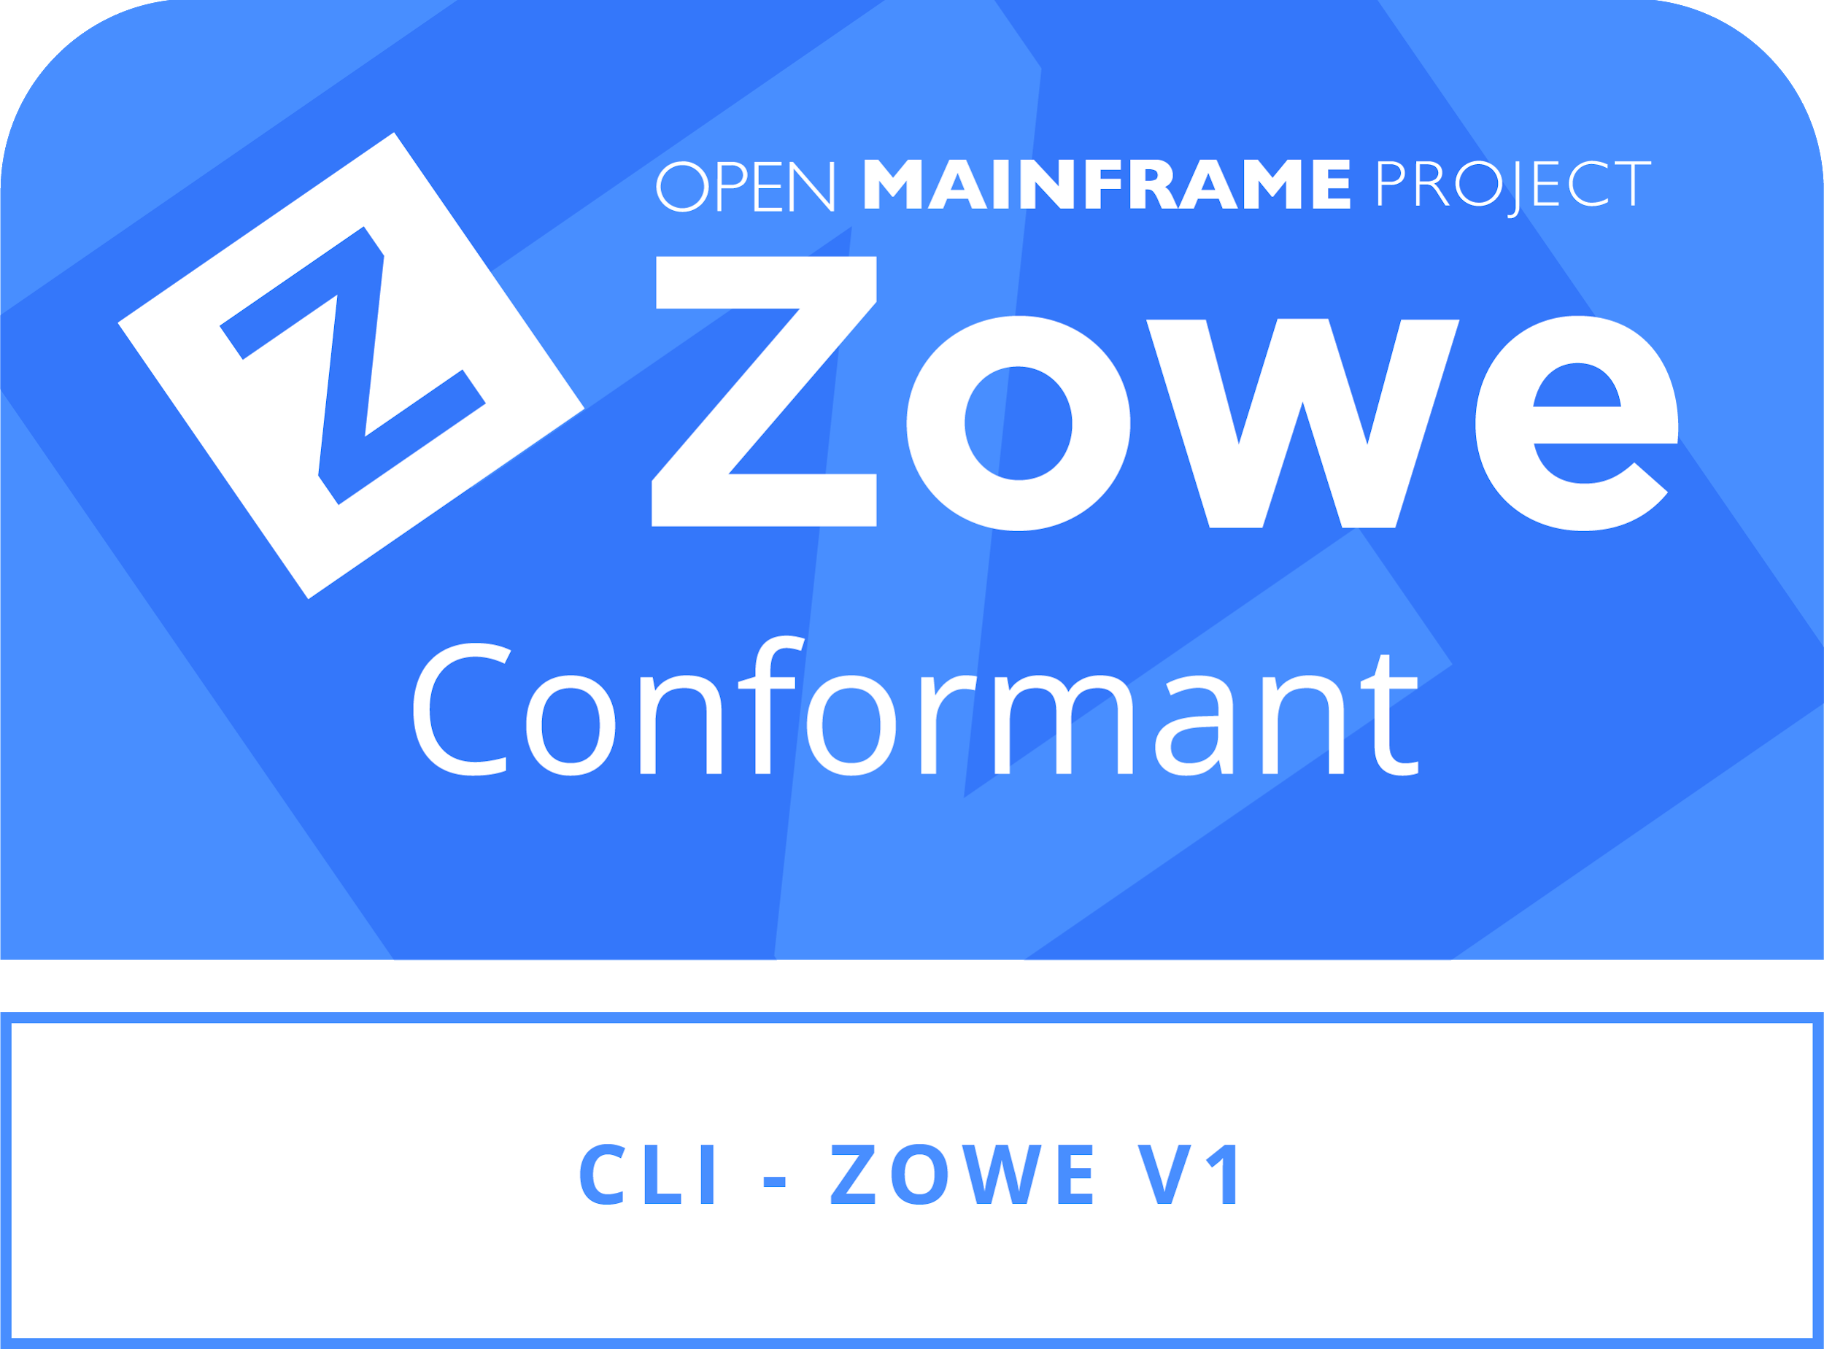

Outreach & Onboarding

Slide 8

Zowe Release Predictability & Reliability
Complete retrospective on current release process and identify roadblocks
Prioritize eliminating key issues
Define & visibly document process for future major releases of Zowe
Photo by Jorge Salvador on Unsplash

